Slide 1






4
1
2
3
GEBZE TECHNICAL UNIVERSITY
Doç. Dr. Murat Oluş ÖZBEK
MUH - 391
HOLISTIC ENERGY OPTIMIZATION IN CAMPUS BUILDINGS
CREW
Fatih Emre OĞAN
Taha Batuhan ÇUBUKÇU
Fatma Yağmur AKBULUT
Mücahit Cem PEKÜZ
DATE
26.03.2026

Slide 2

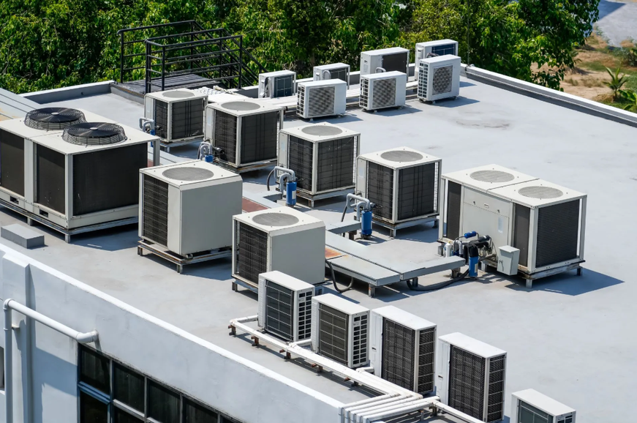


PROBLEM DEFINITION
University campuses have high energy consumption.
A large portion of energy comes from HVAC (heating–cooling) systems.
However, these systems often do not operate efficiently.
Main problems:
Class schedules are used inefficiently
Empty spaces are unnecessarily conditioned
User behaviors cause energy waste
1

Slide 3




PROJECT TOPIC
Developing a holistic system that optimizes energy consumption in campus buildings.
Industry: optimization & decision system
Civil: insulation solutions
Computer: software & data
Chemistry: energy modeling
Approach:
Insulation + HVAC + occupancy density are considered together
An interdisciplinary solution is applied
2

Slide 4
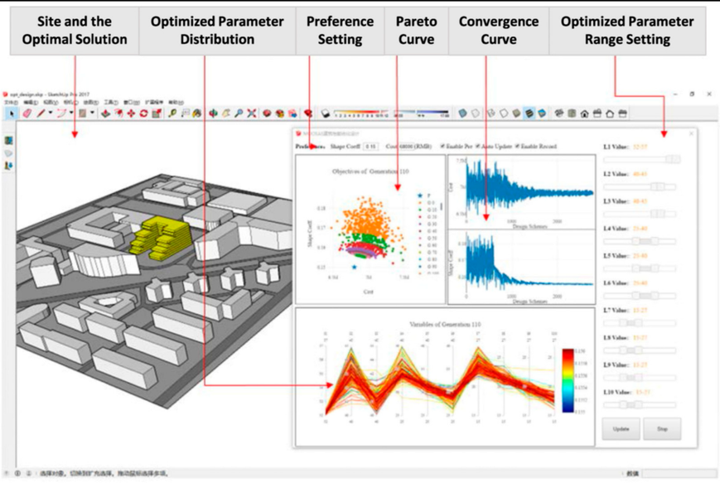
PROJECT OBJECTIVE
Developing an integrated model that reduces energy waste.
Targets:
Smart air conditioning according to class schedule
Reducing energy demand with insulation
Establishing a simulation + optimization system
Including user behavior in the model
Developing an applicable and user-friendly tool
3

Slide 5
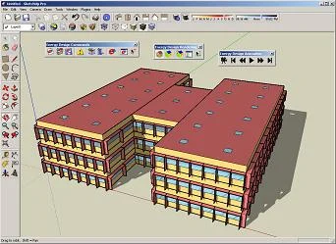
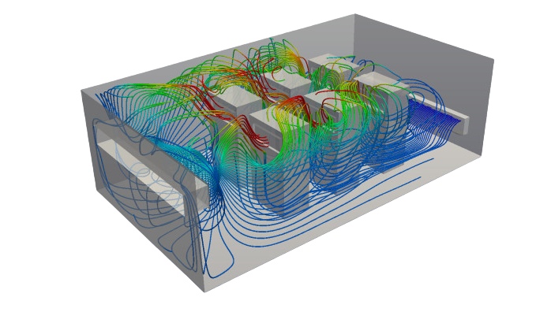
PROJECT SCOPE
What will be done in the project:
Collection of building data
Creating an energy simulation model
Adding occupancy density to the model
Insulation and structural improvements
Analysis of HVAC scenarios
Economic analysis (cost & payback)
4

